Slide 1
Superstore Dataset

Slide 2
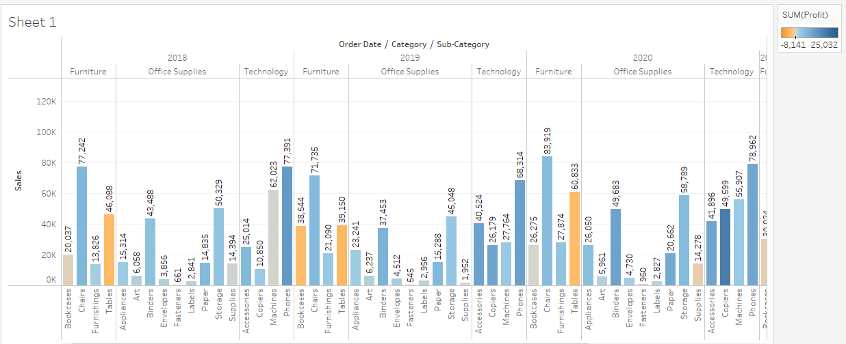
Find the profit and sales for each subcategory of every type of product?

Slide 3
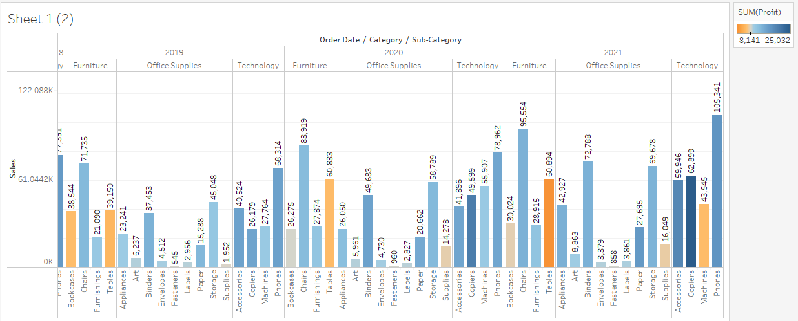

Slide 4
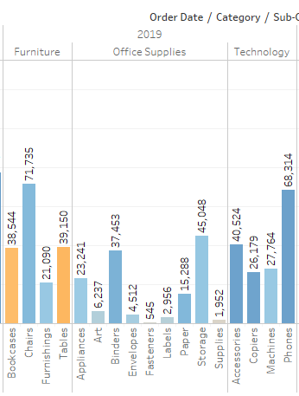
Which subcategory has highest profit in the year 2019?

Slide 5
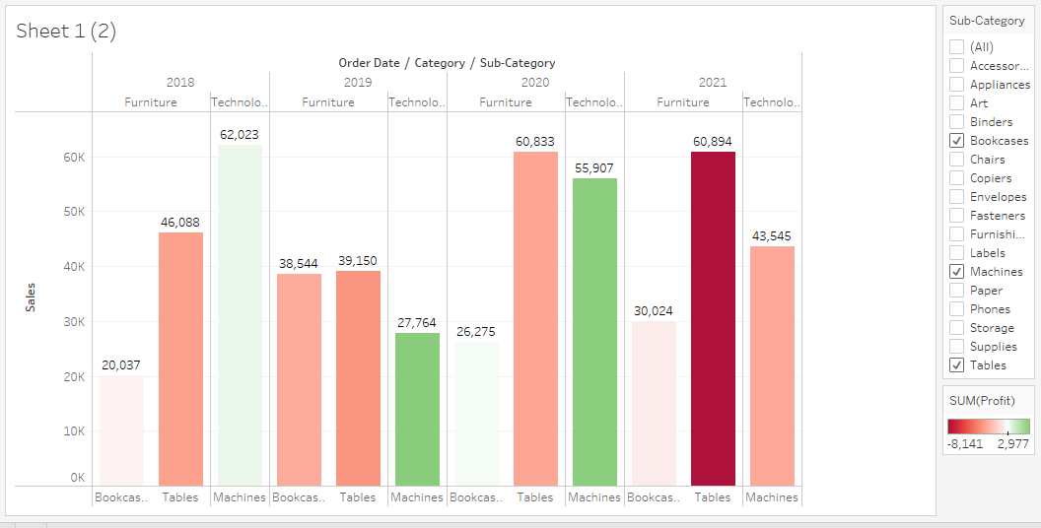
In the view, in the Sub-Category filter card, clear all of the check boxes except Bookcases, Machines, and Tables to have closer look on each value.

Slide 6
Find out the key insights about in which year bookcases and machines were profitable and unprofitable?
MACHINES
Highest profit came in 2019 and lowest was in the year 2021.
BOOKCASES
Highest profit came in 2020 and loses in all other years but the highest loss was in the year 2019.

Slide 7
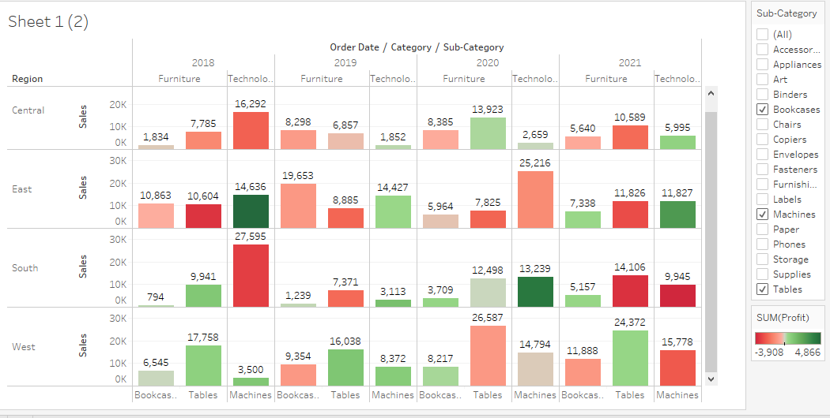
Show the sales region wise for every subcategory and category and every year

Slide 8
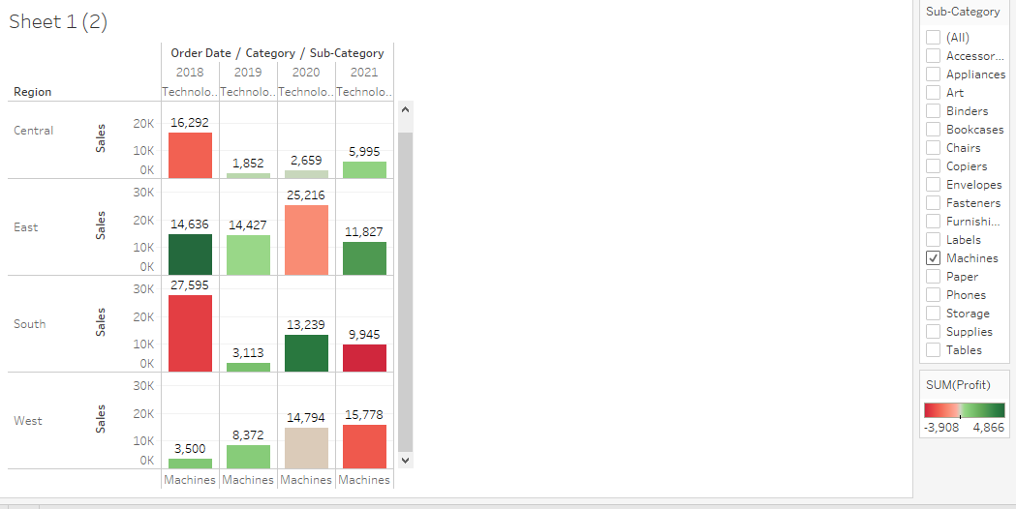
Duplicate your worksheet and check sales region vise for Machine type subcategory.

Slide 9
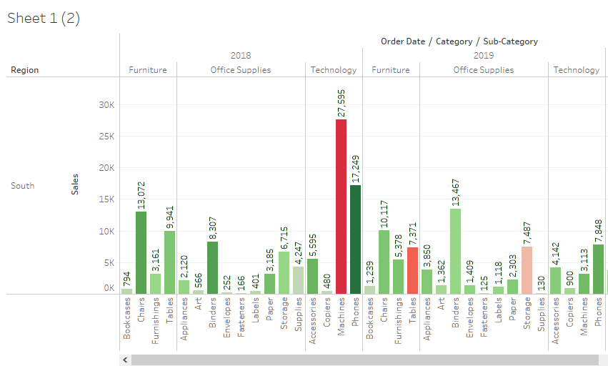
Show your view for Sales in the South for all subcategory.

Slide 10
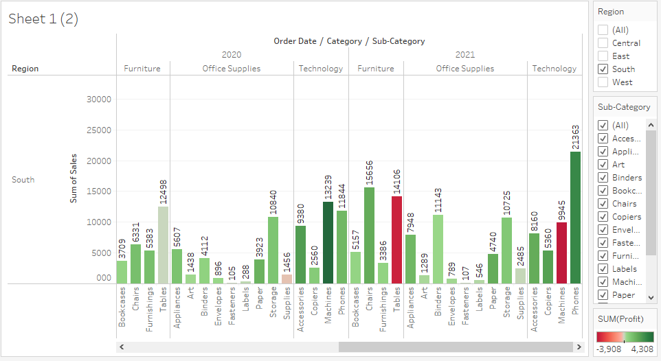

Slide 11
Which subcategory has highest overall negative sales in the south region?
Machine and Tables

